Slide 1
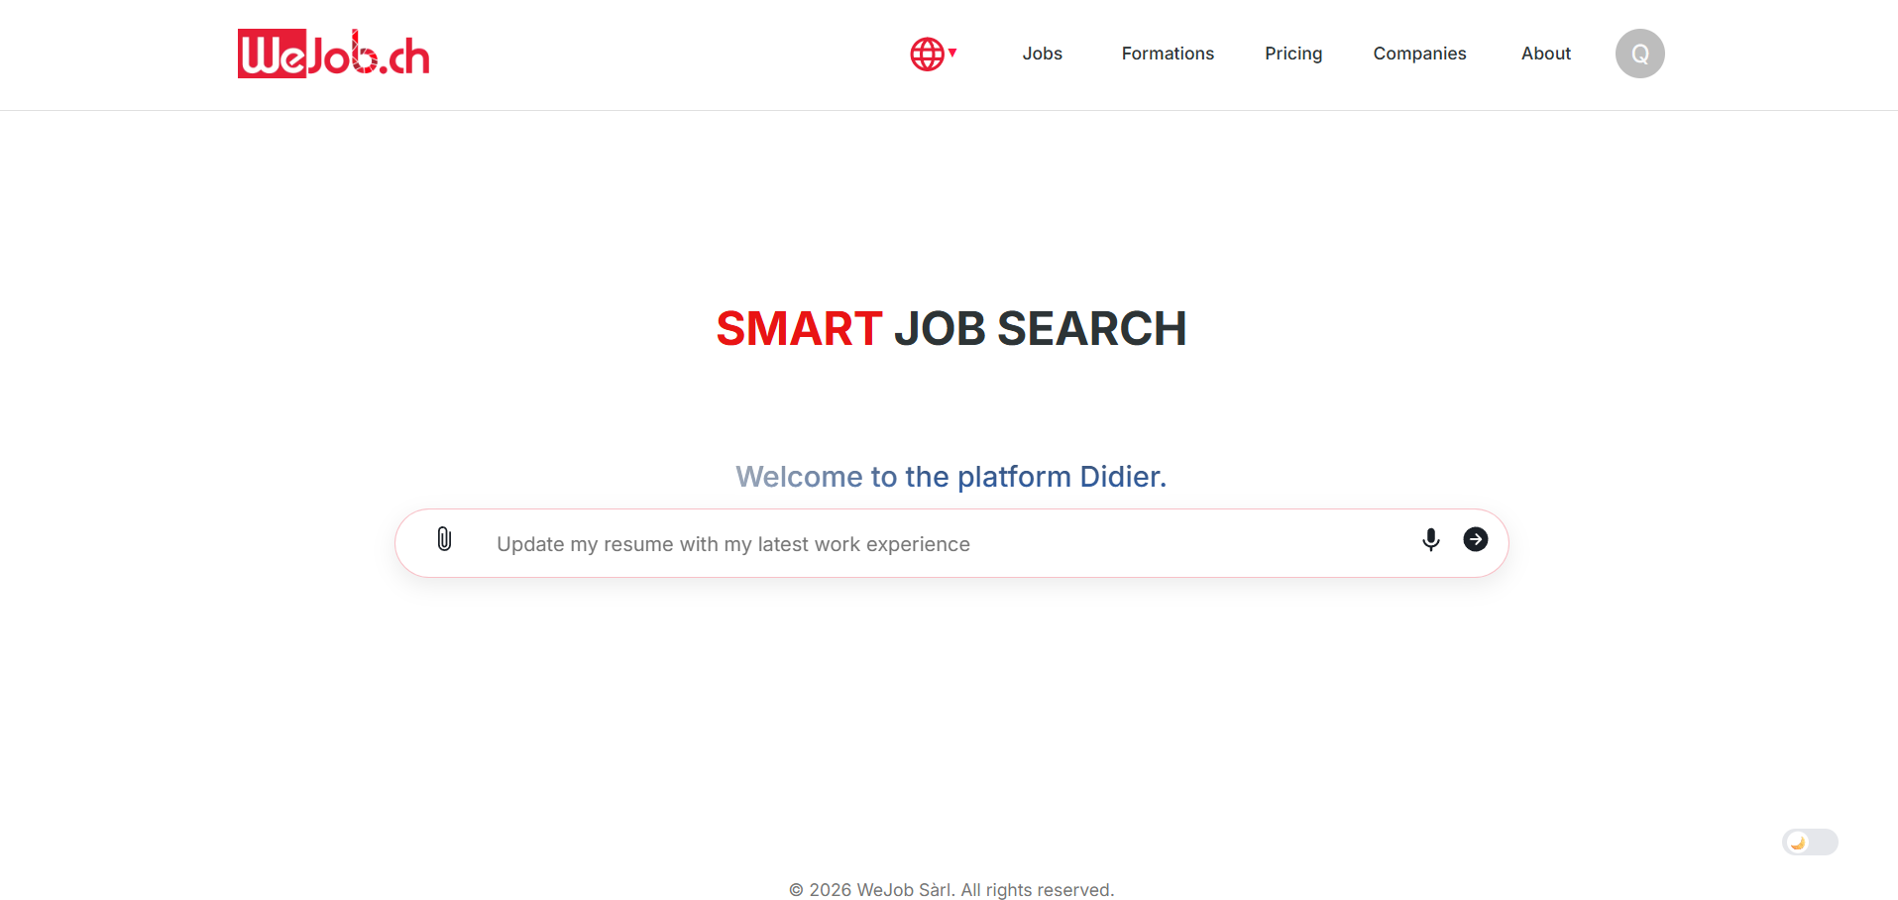
Notes:
Finding an internship abroad is already difficult.
But entering the Swiss job market when you’re not Swiss can be even more challenging.
Students often struggle to understand what companies are really looking for and if their profile truly fits the position.
This is exactly the kind of problem the platform WeJob aims to solve.

Slide 2
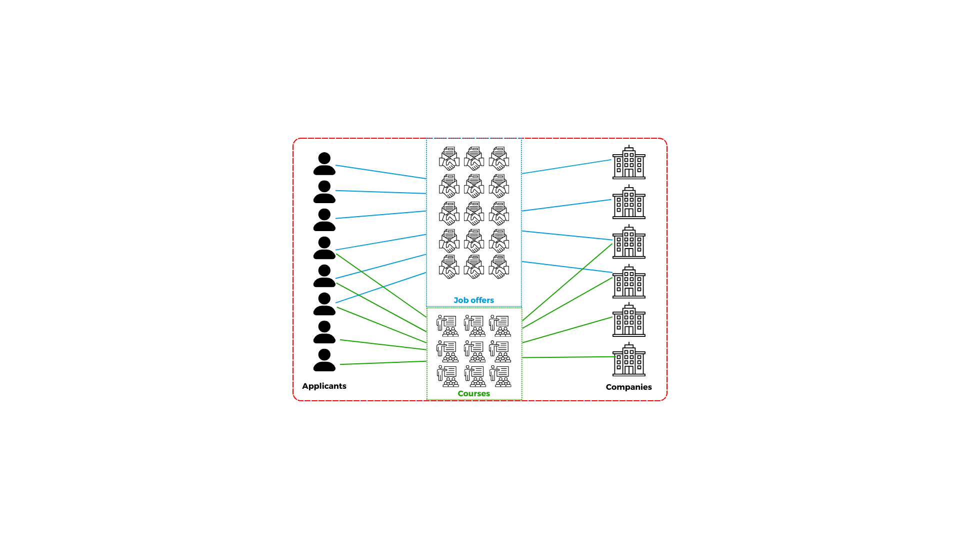
The platform
WeJob
Notes:
WeJob connects applicants and companies through job offers and courses on the platform.
The goal is to simplify recruitment by helping applicants find relevant jobs and allowing recruiters to quickly reach suitable profiles.

Slide 3
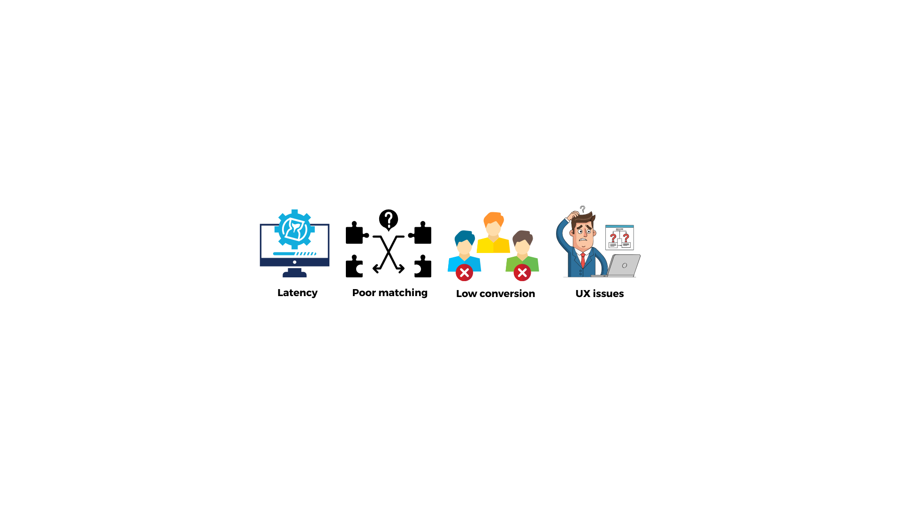
Problems
Latency
Poor matching
Low conversions
UX issues
Notes:
However, the platform faces several challenges.
Indeed there are performance issues, with noticeable latency.
The matching system doesn’t produce relevant results.
So, the conversion rate is low, few users actually find a job through the platform.
Finally, there are several user experience issues.

Slide 4
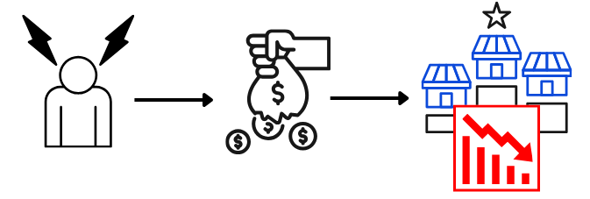
Why they mattered
Important business impact !
User frustration
Lost opportunities
Market competitiveness

Slide 5

Project goal - Our job
Clear objective :
Improve job matching relevance

Slide 6
Collaboration
Ruben
Marc
Mélany
Akram
Jessy
Loan
Fatemeh
Arthur
Chloé
José Paul
Nithusan
Notes:
For this project, our team is composed of Arthur, Akram, Jessy and myself. We are working in collaboration with the client's team from Geneva (on the right). Our main point of contact is Ruben, the project leader.

Slide 7

Constraints
…
Swiss market specifics & Multilingual
Data privacy
Legacy systems
Notes:
Regarding constraints, we had to familiarize ourselves with the Swiss market specifics and its multilingual aspect, ensure the confidentiality to maintain user trust and follow legal requirements. Our work integrates an existing system that requires adaptation.

Slide 8
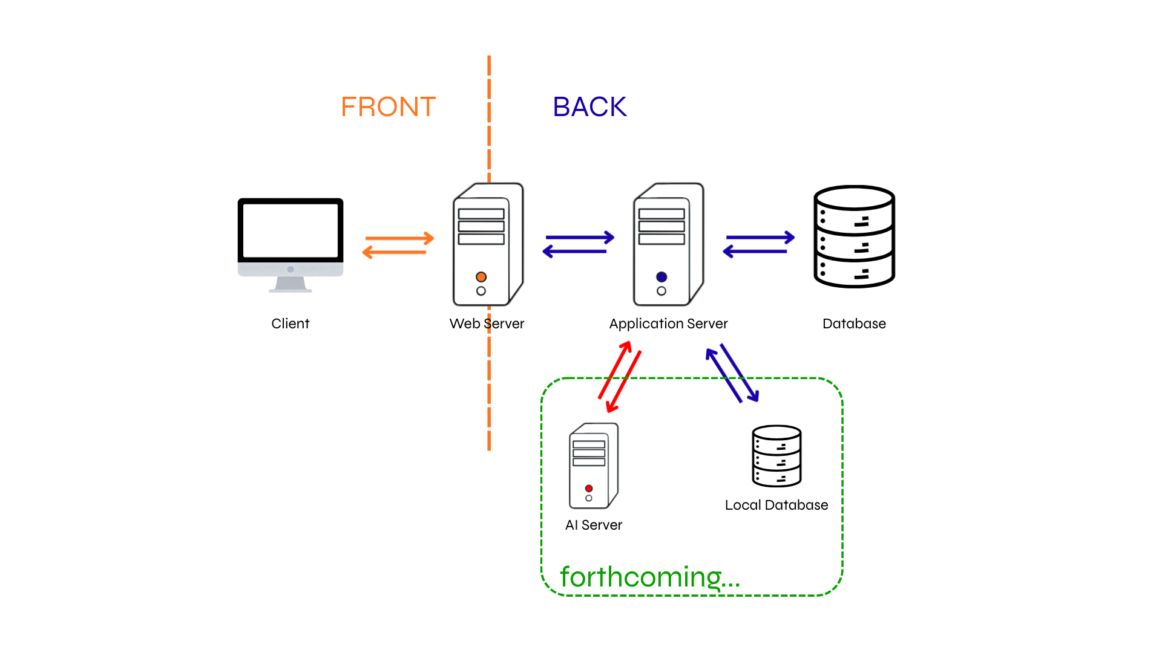
High-level architecture

Slide 9
High-level architecture

Slide 10
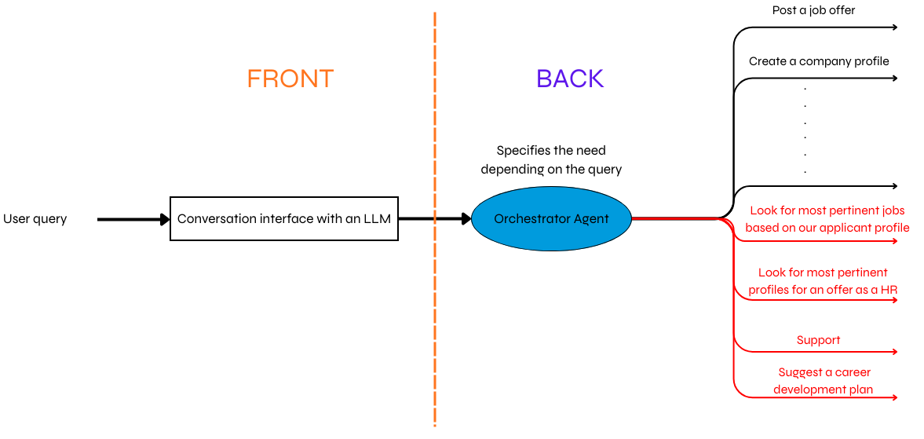
In-architecture

Slide 11
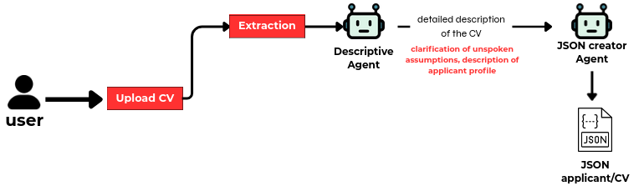
Deep dive: data structuring

Slide 12
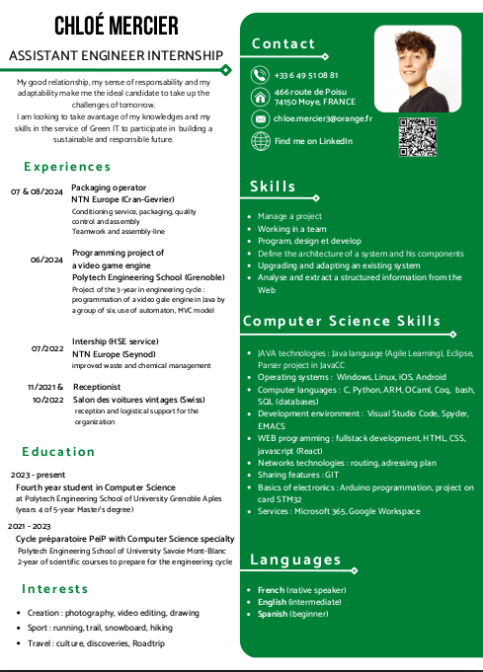
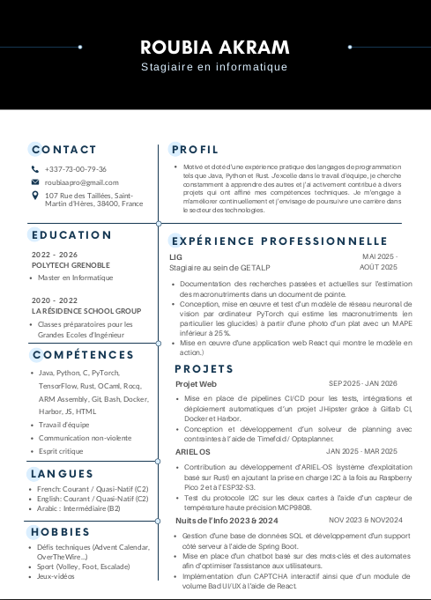
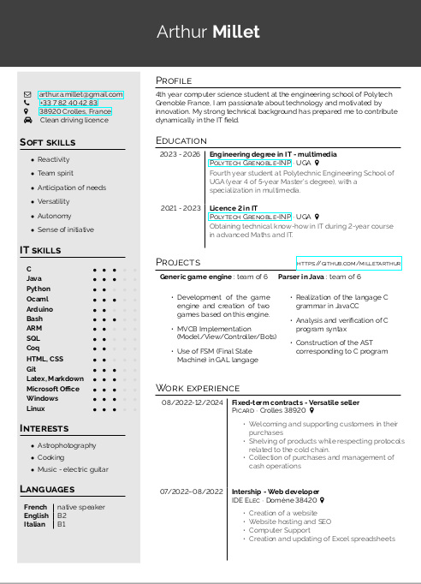
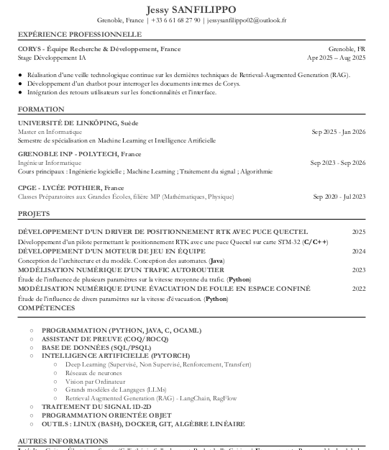
One of the technical challenges
Data extraction : PDF format
Very unstructured format!

Slide 13

How we faced it
Wrote scripts in Python
Used a library called Docling
Uses several AI models to transcribe a complex document into a structured one.
Results were satisfying.

Slide 14
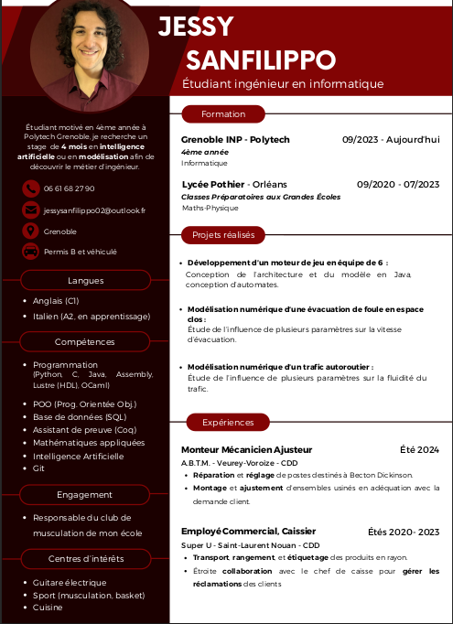
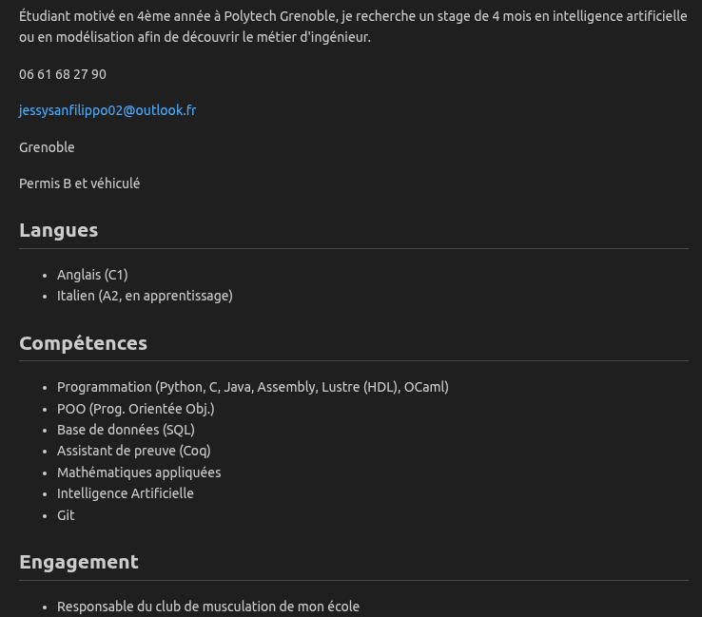
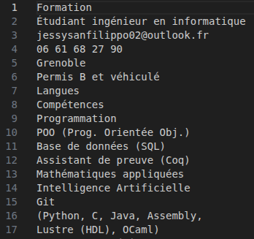
Results

Slide 15

Functional scope
Support
6
Advanced matching
4
5
3
Career path
1
2
Fix job form
Fix applicant registration
Simplified matching
Notes:
During the project, we fixed the applicant workflow, the job offer publication process, and implemented a first version of an intelligent matching system.
Due to time constraints, we did not implement an advanced matching, a personalized career paths, and an AI support assistant for users.

Slide 16
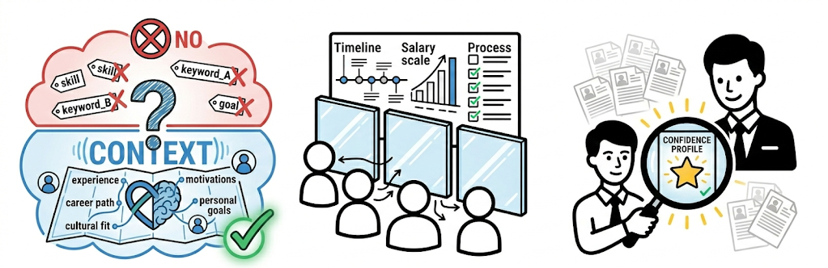
What we learned
Applicants need
transparency
Recruiter look for confidence, not volume
Context over keywords
Notes:
Through this project, we learned three important things.
First, good matching requires context, not just keywords.
Second, applicants need transparency about opportunities before they decide to apply.
And third, recruiters prefer quality over quantity.

Slide 17

User impact
Efficiency and speed !
Applicant
Recruiter
Notes:
Regarding user impact, the matching between offers and applicants streamlines the recruitement process improving both efficiency and speed. As a result, applicants can apply more easily, while the recruiters identify better profiles.

Slide 18

Business impact
Adoption
Retention
Employer satisfaction
Notes:
Our goal is to meet user needs through a modern concept ensuring a high adoption rate. Applicant retention will allow us to continuously enrich the CVtech which is key to keep the employer satisfaction.

Slide 19

What’s next
Support
Matching
applicants←→ courses
Career path
Complex matching
applicants ←→ jobs
Notes:
Future developments could include a matching between applicants and courses, an AI to predict the career path, a technical support service or optimizing the matching algorithm between applicants and offers.

Slide 20

You bring the spark; we’ll handle the search.
WeJob

